Slide 1

FINAL YEAR PROJECT ON REAL-TIME FACIAL RECOGNITION FOR AUTOMATED ATTENDANCE APPLICATION
Hindustan College of Science and Technology, Farah, Mathura
Department of Information Technology
Project Guide:
Mr. Ajay Parashar
Group Members:
Prateek Mudgal (2200640139003)
Priyanshi Chaudhary (2200640139004)
Shivam Sorot (2200640139005)
Group ID:
HCST/IT/2024/12

Slide 2
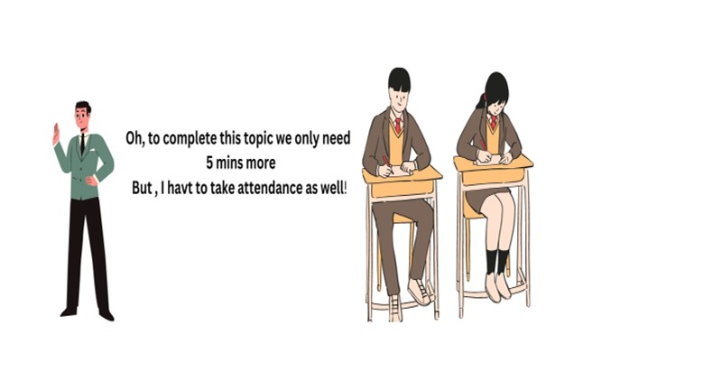
Introduction to Project
Problem Statement-
In the traditional system, the teacher calls out each student's name or roll number and makes a physical attendance sheet, which is very time-consuming.
Students who arrive late to class receive full attendance, which is unfair to those who attend the entire lecture.
The traditional system is prone to human error.
A major issue in the traditional system is proxy attendance.
Teachers lose valuable class time while taking attendance.
The traditional method involves a lot of paperwork, contributing to environmental waste.

Slide 3
Existing System
Manual Attendance Logging:
In most traditional settings, attendance is marked manually.
Can involve paper records or simple digital biometric.
Attendance Backlog Issue: In our college’s SIM system, if attendance is not updated within the designated time frame, it goes into a backlog. This requires teachers to manage students’ attendance manually, creating challenges in accurately tracking and updating attendance records.
Percentage-Based Attendance Calculation Problem: The SIM system calculates attendance as an overall percentage, with present days increasing attendance by 3% and absences reducing it by 2%. This creates an issue for students who attend consistently for a recent period but had poor attendance in the previous month.
Problems with Existing System
Time Delays: Manual entry wastes time for staff and students/employees.
Inaccuracy: Prone to errors and sometimes intentional manipulation (e.g., proxy attendance).
Data Management: Difficult to manage, retrieve, and analyze attendance data over long periods.
Lack of Scalability: Inefficient for larger organizations or multiple locations.

Slide 4
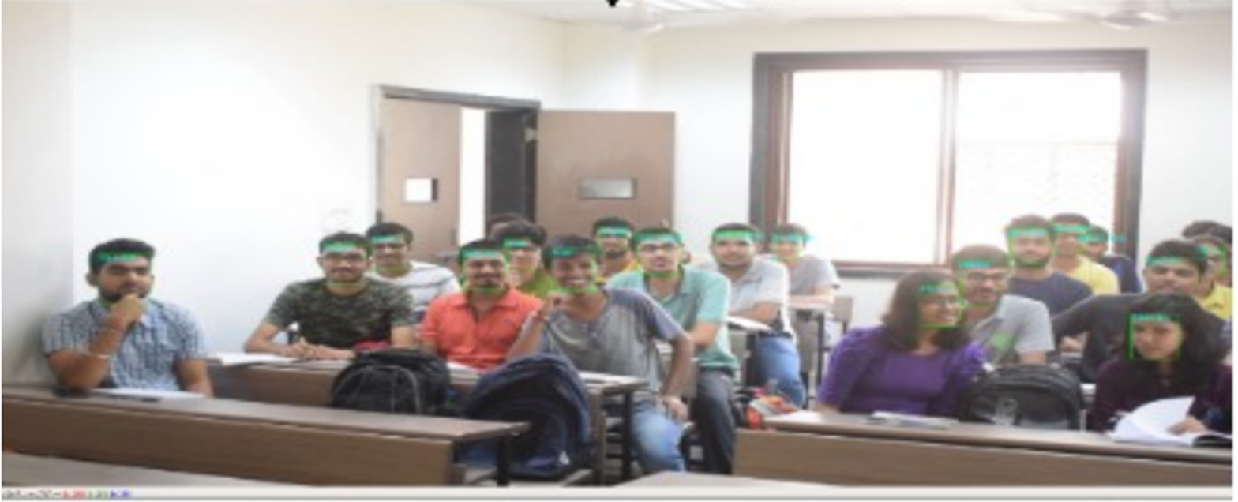
Proposed System
Solution:
Real-time facial recognition-based attendance.
Eliminates manual input and improves accuracy.
Contactless attendance marking.
Secure, efficient, and scalable.
Data stored digitally in an Excel sheet for easy management.
System captures and processes images periodically (e.g., every 30 minutes).
All attendance records saved in an Excel sheet for easy access and review.
System Process Flow:
Face Detection: The system uses a camera to detect faces in real-time.
Face Recognition: Detected faces are compared to the database for matching.
Attendance Marking: Once matched, attendance is logged automatically in an Excel Sheet.
Data Storage: Attendance records are stored, timestamped, and organized
(Reference: https://ieeexplore.ieee.org/document/9029001
Aashish Rai, Rashmi Karnani, Vishal Chudasama, Kishor Upla

Slide 5
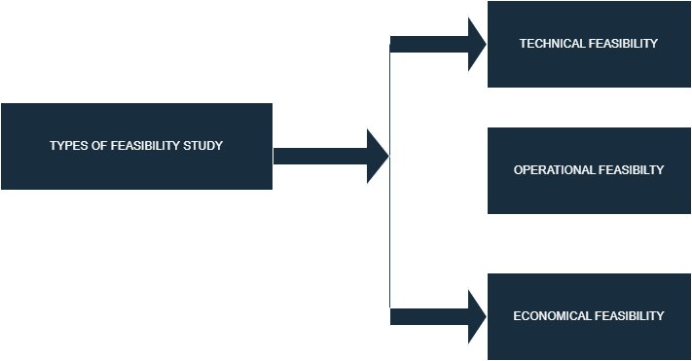
Feasibility study
A feasibility study is an analysis that evaluates whether a proposed system or project is viable and practical within various constraints, such as technical capabilities, operational requirements, and economic impact. It helps decision-makers understand if the project should proceed or not.
Types of Feasibility
Technical Feasibility: Can the project be developed with current technology and tools?
Operational Feasibility: Will the system meet user needs and integrate smoothly into existing operations?
Economic Feasibility: Will the project's benefits justify the financial investment?

Slide 6
Technical feasibility
Technical feasibility assesses if the required technology is available and capable of supporting the project’s development and goals. It involves determining whether the necessary tools and algorithms can be implemented effectively for real-time facial recognition.
Technologies:
OpenCV: A robust computer vision library that provides tools for face detection and preprocessing tasks, such as image manipulation and scaling.
DeepFace: For deeper face recognition capabilities, DeepFace we are using. This model enable high-accuracy facial recognition by mapping faces into a high-dimensional space, allowing precise identification and differentiation between faces.
Python: The primary language for development due to its rich libraries and support for machine learning, image processing, and server-side programming.
Streamlit (Web Framework: Streamlit, an intuitive and lightweight Python framework, is used to build the user interface of the system. This interface enables administrators to efficiently manage attendance data, view records, add or delete users, and monitor attendance.
MTCNN (Multi-Task Cascaded Convolutional Neural Networks): MTCNN is used in the face detection pipeline to locate and align faces within captured images, enhancing the quality of data fed to DeepFace for recognition.

Slide 7
Technical feasibility
Hardware Requirements:
Cameras: A high-definition webcam with at least 720p resolution for clear image capture; an IP camera can also be used if a wider area needs to be covered.
Computer (PC): Preferably with a multi-core processor, such as Intel i5 or above, or AMD Ryzen 5, to handle real-time video processing and facial recognition tasks.
RAM: Minimum 8GB RAM for smooth operation; 16GB or higher is recommended for faster processing.
Storage: 256GB SSD for faster data read/write; SSD storage improves system speed, especially when handling large image datasets.
Wi-Fi/Internet Connection: Required if data is stored or accessed on a remote server, or for remote access to the application.
UPS (Uninterruptible Power Supply): For System Continuity and Stability.

Slide 8
Operational Feasibility
Operational feasibility examines if the project will function effectively in its intended environment, meeting user needs and being sustainable over time with minimal intervention.
Automation and Ease of Use:
The system eliminates the need for manual attendance, reducing errors and ensuring reliability. By setting regular scans (e.g., every 30 minutes), the system automates attendance logging with minimal human oversight.
User Interface (UI):
The system should have an intuitive, user-friendly interface to make it easy for administrators to access attendance logs, configure settings, and manage records.
Integration with Existing Systems:
The attendance data can be stored in a database, allowing easy export to formats like Excel. This facilitates integration with other administrative software and aids in reporting, making the system suitable for educational institutions or offices.

Slide 9
Economic Feasibility
Economic feasibility determines if the financial benefits of the project outweigh its costs. This includes the initial setup cost, ongoing operational costs, and the long-term savings and benefits.
Initial Setup Costs:
Hardware Investment: Cameras, servers are essential for running the system. These initial costs can vary depending on the institution’s size and requirements.
Software and Licensing: Libraries like OpenCV are open-source, reducing software costs.
Development and Deployment Costs: Costs associated with software development, training the model, and deploying the system should be accounted for.
Ongoing Costs:
Maintenance: Regular maintenance for cameras and hardware is necessary, as well as periodic software updates for security and feature improvements.
Operational Costs: Costs for server hosting and electricity, especially for larger institutions, need consideration.
Long-Term Savings:
Reduction in Manual Labor: By eliminating manual attendance tracking, the system saves substantial labor costs for teachers or administrators responsible for attendance.
Error Reduction: Reducing errors in attendance records prevents administrative time and resources spent correcting inaccuracies, particularly valuable in environments with strict attendance policies.

Slide 10
Cost Estimation
Hardware
Computers (PCs):
Requirement: 3 units for development, testing, and deployment.
Specification: Each with Intel i5/Ryzen 5 processor, 8GB RAM, 256GB SSD.
Cost per Unit: Approximately ₹50,000.
Total Cost: ₹50,000 x 3 = ₹1,50,000.
High-Definition Webcams:
Requirement: 3 units for capturing facial data.
Brand: CP PLUS
Model Name: CP
Connectivity Technology: Wireless
Special Feature : HD Resolution, 2 Way Audio, Night Vision, Motion Sensor
Indoor/Outdoor Usage: Indoor
Compatible Devices: PC, Smartphone
Connectivity Protocol: Wi-Fi
Cost per Unit: Approximately ₹1200.
Total Cost: ₹1200 x 2 = ₹24,00.
Networking Equipment:
Components: Routers, switches, and cabling.
Estimated Cost: ₹5,000.
UPS(Uninterruptible Power Supplies):
2 Battery and 1 Inverter = ₹30,000.
Software Cost
Python, Deepface, Opencv, flask, SQL, IDE all are free of cost.
Manpower Costs
Machine Learning Engineers:
Requirement: 3 freshers.
Average Annual Salary per Engineer: Approximately ₹4,00,000LPA
Project Duration: 8 months.
Total Cost: ₹2,66,666 x 3 x 8 = ₹8,00,000.
Total approx. cost of the project = ₹1,50,000 + ₹24,00 + ₹30,000 + ₹5,000 + ₹8,00,000 = ₹9,87,400.

Slide 11
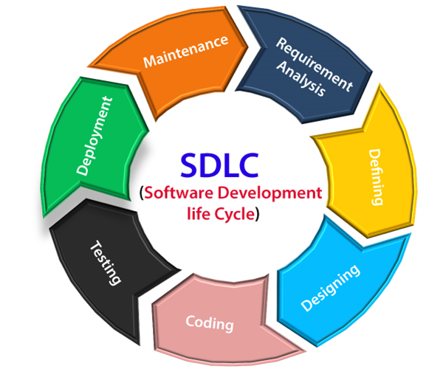
Software development model
SDLC (Software Development Life Cycle) is a structured process or methodology used to develop software applications in a systematic and efficient way. It outlines the stages or phases involved in creating software, from the initial planning to the final deployment and maintenance.

Slide 12
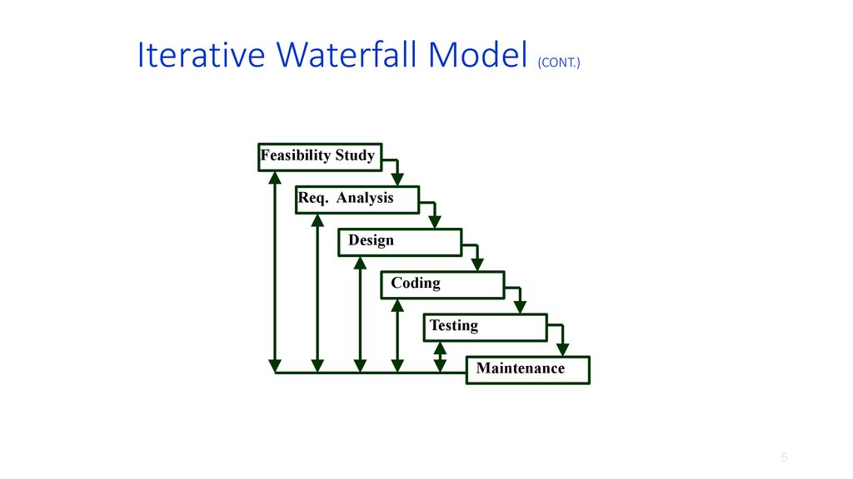
Iterative Waterfall Model
The Iterative Waterfall model includes feedback loops that allow each phase to revisit and refine the previous phases as needed.
(Reference:
Software Engineering by Prof. Rajib Mall
Indian Institute of Technology, Kharagpur)

Slide 13
Pros and Cons
Pros
Cons
Structured Approach
Early Detection of Issues
Better Requirements Understanding
Improved Flexibility
Documentation and Tracking
Limited Customer Involvement
Increased Project Duration
Resource-Intensive
Difficulty in Handling Changes
Not Ideal for Complex Projects

Slide 14
Why we choose this model?
It follows a well-defined, step-by-step process that's easy to manage.
Iterations allow for feedback early, reducing risks later in the project.
Iterative cycles help refine and clarify requirements over time.
Regular assessments after each phase allow for early risk detection.
The model ensures thorough documentation at each stage for easier tracking.
Iterative testing and refinement improve the overall quality of the product.

Slide 15
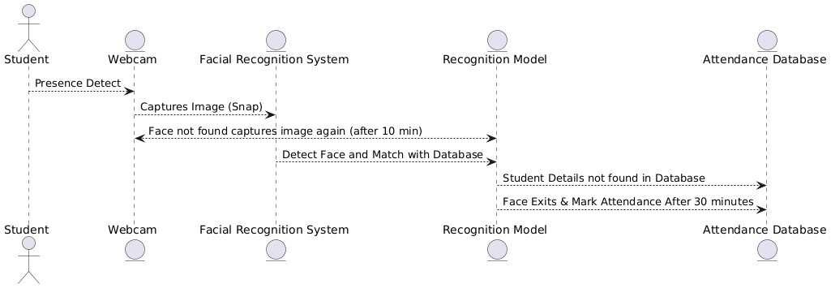
System Architecture
.

Slide 16
Data Flow Diagrams
A Data Flow Diagram (DFD) is a graphical representation that illustrates the flow of data within a system, including the processes, data storage, and data movement. It’s commonly used in system analysis and design to understand and document how data flows through a process or system.
Key Components of a DFD:
Processes: Represented by circles or rounded rectangles, processes show how data is transformed or manipulated (e.g., processing an order, validating a user).
Data Stores: Represented by open-ended rectangles, data stores are places where data is held (e.g., a database or file).
Data Flows: Represented by arrows, these show the direction of data movement between processes, data stores, and external entities.
External Entities: Represented by rectangles, these are sources or destinations of data outside the system, such as users, other systems, or departments.
Levels of DFD:
Level 0 (Context Diagram): The highest-level DFD, giving an overview of the entire system as a single process with external entities and main data flows.
Level 1: Breaks down the main process into sub-processes, showing more detail about data flows and interactions within the system.
Level 2 (and beyond): Provides even more detail by breaking down processes further to show finer details of the data flows and operations.

Slide 17
Level 0 DFD
.
Student
INPUT IMAGE
DISPLAY OUTPUT
Student Info
Attendance Status
Automated Attendance App.

Slide 18
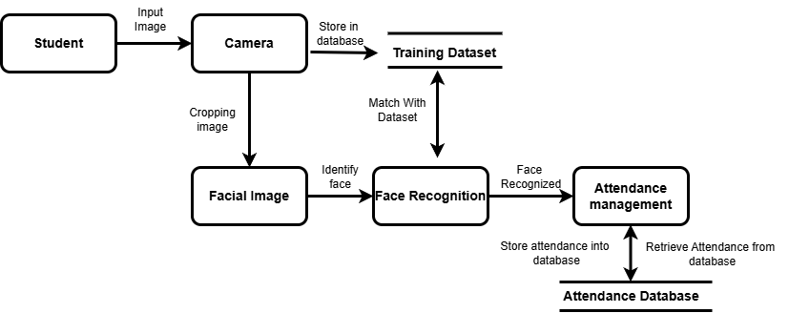
Level 1 DFD
Output
Student Info
Attendance Status

Slide 19
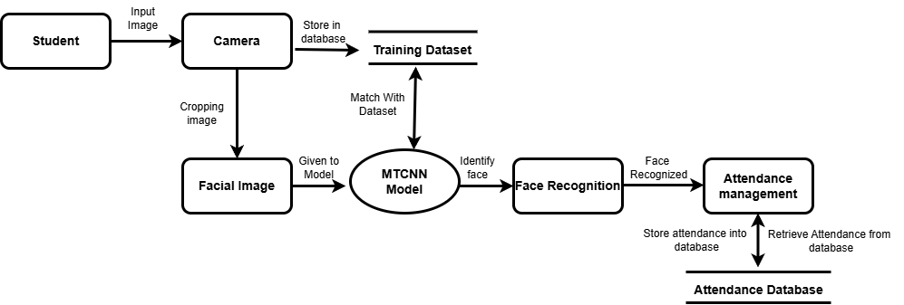
Level 2 DFD
Output
Student Info
Attendance Status

Slide 20
Existing Attendance Management System
Manual Attendance Systems (Paper-Based Roll Calls)
Biometric Attendance Systems
RFID-Based Attendance Systems
Smart Card Attendance Systems
Cloud-Based Attendance Systems
Mobile-Based Attendance Systems
AI-Based Attendance Systems

Slide 21
Manual Attendance Systems
Features:
Simple and straightforward, using pen and paper for attendance.
Low cost, requiring no technology or advanced equipment.
Minimal training needed for those managing the system.
Challenges:
Human Error like Prone to inaccuracies from manual entries or mistakes.
Time-Consuming for recording and verifying attendance is slow.
Limited Security as no way to prevent “proxy” or buddy punching.
Data Handling not practical for large organizations and hard to analyze or integrate with digital payroll systems.

Slide 22
Biometric Attendance Systems
Features:
High Accuracy like uses unique identifiers (fingerprint, face, iris) for precise identification.
Prevents buddy punching as eliminates proxy attendance since biometrics are unique.
Automated record keeping for Time logs are recorded digitally and stored securely.
Integration for Compatible with payroll and HR systems for attendance-based payments.
Challenges:
Privacy Concerns collection and storage of biometric data may raise privacy issues.
Hygiene some users are concerned with hygiene, especially with fingerprint scanners.
Technical Issues like biometrics may fail with minor physical changes (cuts on fingerprints, eye issues) or power/network outages.
Cost maintenance costs, especially for advanced systems like iris or facial recognition.

Slide 23
RFID-Based Attendance Systems
Features:
Non-Intrusive is employees swipe or tap RFID-enabled cards, which is fast and contactless.
Automated Tracking as Logs entry and exit times automatically.
Scalability like suitable for large organizations; integrates with access control for restricted areas.
Durable RFID cards are long-lasting and require minimal maintenance.
Challenges:
Buddy Punching like If cards are shared, one person can clock in for another.
Loss of Cards like Employees may lose or forget cards, leading to tracking issues.
Initial Setup Cost like Installing RFID readers at every entry/exit point can be costly.
Security cards can be cloned or tampered with if not well-secured.

Slide 24
Smart Card Attendance Systems
Features:
Convenience like employes tap a smart card to mark attendance, which is quick and contactless.
Data Storage is smart cards can store additional data, enabling integration with other systems.
Access Control is can restrict access to certain areas and log times automatically.
Customizable is often programmable for different user levels and access.
Challenges:
Buddy Punching as cards can be shared, allowing proxy attendance.
Loss or damage like employees may lose or damage smart cards, causing disruptions.
Cost higher initial and replacement costs compared to standard ID cards.
Security risks as cards can be cloned, posing potential security issues.

Slide 25
Cloud-Based Attendance Systems
Features:
Remote access like data is stored online, allowing access from any location.
Real-Time monitoring as Managers can monitor attendance data in real time.
Data security as cloud providers offer security and backup for stored data.
Integration as easily integrates with payroll, HR, and reporting systems.
Challenges:
Internet Dependence as requires a stable internet connection.
Data Privacy as storing data on third-party servers may raise privacy concerns.
Subscription costs as may involve ongoing subscription fees.
Technical expertise requires setup and management expertise.

Slide 26
Mobile-Based Attendance Systems
Features:
Location Tracking as uses GPS to verify attendance at specific locations.
Remote Check-In for employees can mark attendance from any location, ideal for field employees.
Ease of use is simple for employees to mark attendance with a smartphone app.
Push notifications like can send reminders for check-in/check-out.
Challenges:
Privacy Issues for GPS tracking may be seen as invasive.
Battery/Connectivity like depends on the device’s battery and internet connection.
Device Dependency as not all employees may have compatible devices.
Security as phones may be lost or compromised, risking unauthorized access.

Slide 27
AI-Based Attendance Systems
Features:
High Accuracy is AI-powered facial recognition accurately identifies individuals.
Contactless as employees don’t need to touch or use any device.
Real-Time Processing is AI can detect and recognize individuals instantly, useful in large organizations.
Analytics is advanced data insights on attendance patterns and trends.
Challenges:
Privacy concerns is faces and other personal data can be sensitive information.
Ethical concerns as AI raises questions about consent and ethical use.
Setup and Maintenance Cost is expensive to install and maintain due to AI infrastructure.
Environmental Dependency as poor lighting or camera quality can affect accuracy.

Slide 28
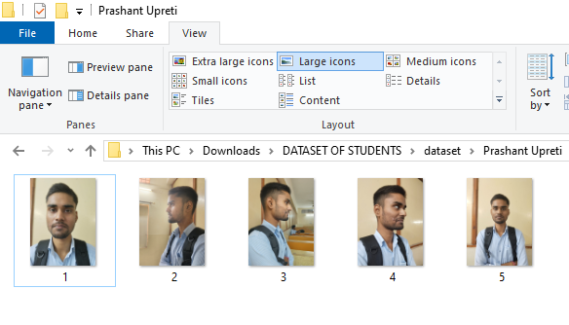
About the Dataset
Building an original, custom dataset with real-time data.
No data is scraped or sourced from external databases.
Initial collection includes raw images of students.

Slide 29
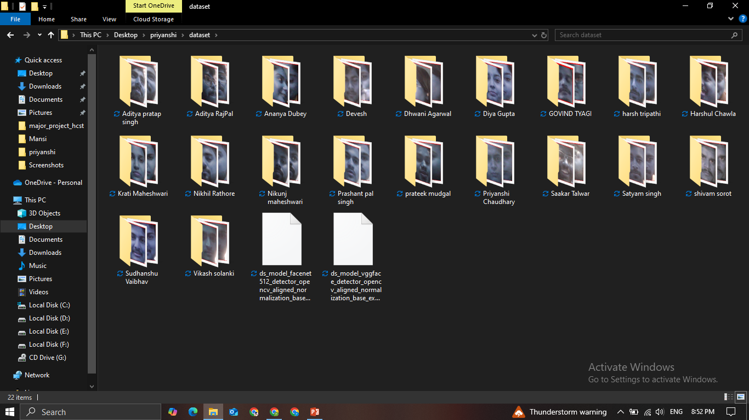
About the Dataset
Prototype Raw Data for Automated Attendance via Facial Recognition

Slide 30
Real Time Data Collection
Write a Python script to automate the image collection process.
Ensure the script captures over 50 images per person within a minute.
Implement efficient image capture and storage to meet real-time needs.
Use automation to trigger image capture without manual intervention.
Optimize the process for scalability, allowing collection from multiple individuals simultaneously.

Slide 31
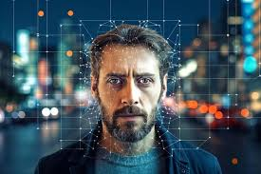
What is an Image
An image is a visual representation of objects or scenes.
Composed of pixels (smallest units of an image) arranged in a grid.
Each pixel has color or intensity values, defining the image's appearance.
https://www.freepik.com/

Slide 32
TYPES OF IMAGE
Binary Images
Grayscale Images
RGB (color) Images
Indexed Images
Multispectral Images.
Used in various fields like photography, computer vision, and remote sensing.

Slide 33
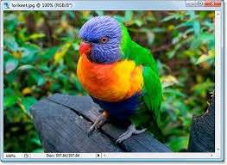
Types Of Images
1. RGB (Color) Images
RGB stands for Red, Green, Blue, the primary colors used to create a wide spectrum of colors.
Each pixel contains three values representing the intensity of Red, Green, and Blue.
24-bit color depth: 8 bits per channel, allowing for over 16 million possible color combinations.
Widely used in digital photography, displays, and web images.
Provides rich color representation, making it ideal for applications requiring detailed and vibrant images.
https://www.photoshopessentials.com/essentials/rgb/

Slide 34
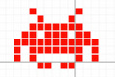
Binary Images
Binary images contain only two colors: black and white (0 and 1).
Each pixel has a value of either 0 (black) or 1 (white).
Often used for high-contrast images or simple data like scanned text or document analysis.
Low storage requirements due to minimal color information.
Common in image processing tasks like edge detection, object recognition, and OCR (Optical Character Recognition).
https://www.teachwithict.com/binary-representation-of-images.html

Slide 35
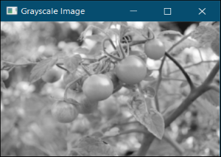
Grayscale Images
Grayscale images contain varying shades of gray, ranging from black (0) to white (255) in 8-bit images.
Each pixel represents intensity rather than color, with a single value per pixel.
Used in image processing tasks like edge detection and facial recognition, where color is not critical.
Reduces data size compared to RGB images, making processing faster and more efficient.
Common in applications like medical imaging, satellite imagery, and computer vision.
4o mini
https://www.geeksforgeeks.org/python-grayscaling-of-images-using-opencv/
https://media.geeksforgeeks.org/

Slide 36
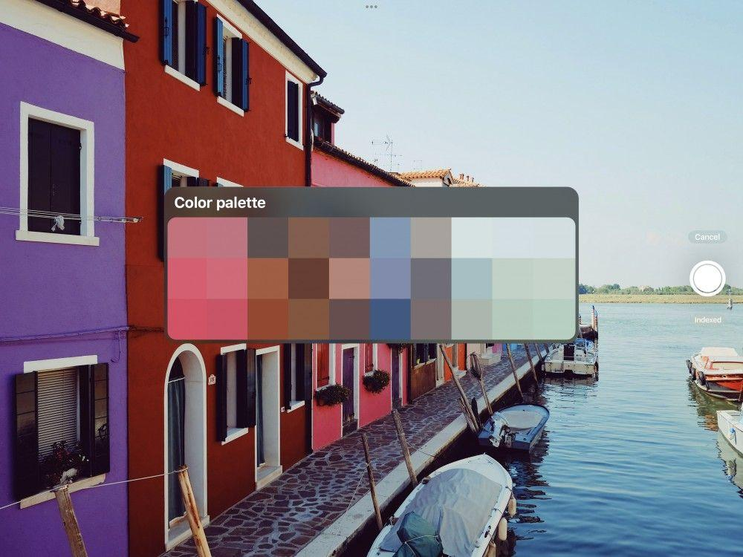
Indexed (Palette) Images
Indexed images use a palette (or color table) where each pixel stores an index to a color in the palette.
The palette contains a limited set of colors, typically 256 or fewer.
Reduced file size compared to RGB images, as pixels reference the palette instead of storing full color values.
Commonly used in image compression formats like GIF and PNG.
Efficient for images with fewer colors, such as logos, icons, or simple graphics.
https://help.procreate.com/procreate/handbook/colors/colors-palettes

Slide 37
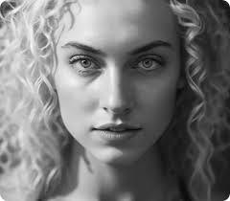
Why grayscale images are preferred?
Simplified Data with Single-Channel Intensity
Key Facial Features Retained Without Color
Reduced Sensitivity to Lighting and Color Variations
Faster Training and Processing for Real-Time Use
https://www.grayscaleimage.com/

Slide 38
Image file extensions
JPEG/JPG (.jpeg / .jpg): Often used for photos and images with lots of colors.
PNG (.png): Supports transparency, widely used for web images.
GIF (.gif): Often used for animations and simple graphics.
BMP (.bmp): Uncompressed, often used in Windows applications.
TIFF (.tiff): Used for high-quality images, popular in professional photography.
WEBP (.webp): Modern format by Google, optimized for web with small file size.

Slide 39
Why we are choosing JPEG?
JPEG is used because it offers efficient compression, reducing file sizes while retaining essential image features, which speeds up processing.
It is a widely supported and commonly used format, making it easy to integrate into various applications, including MTCNN.
JPEG provides a good balance between image quality and file size, ensuring that critical facial features needed for detection are preserved.
Smaller file sizes from JPEG images lead to faster loading and processing times, which is essential for real-time face detection with MTCNN.
JPEG's compression makes it ideal for managing and storing large datasets of facial images without significant loss of important details.

Slide 40
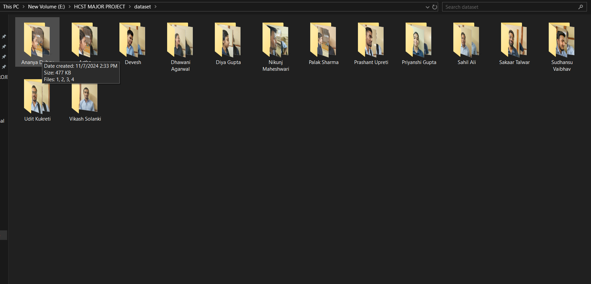
Size of Images
First Folder (477 KB for 4 images)
Original image sizes:
145 KB
83 KB
133 KB
118 KB
Estimated Grayscale File Sizes:
The grayscale conversion can reduce the file size by about 10-30%, so the new sizes could be around 70-90% of the original sizes.
145 KB → 90% of 145 KB = ~131 KB
83 KB → 90% of 83 KB = ~75 KB
133 KB → 90% of 133 KB = ~120 KB
118 KB → 90% of 118 KB = ~106 KB
Total estimated size after grayscale conversion: 131 KB + 75 KB + 120 KB + 106 KB = 432 KB Hence, 9% reduction in size from 477 KB to 432 KB.

Slide 41
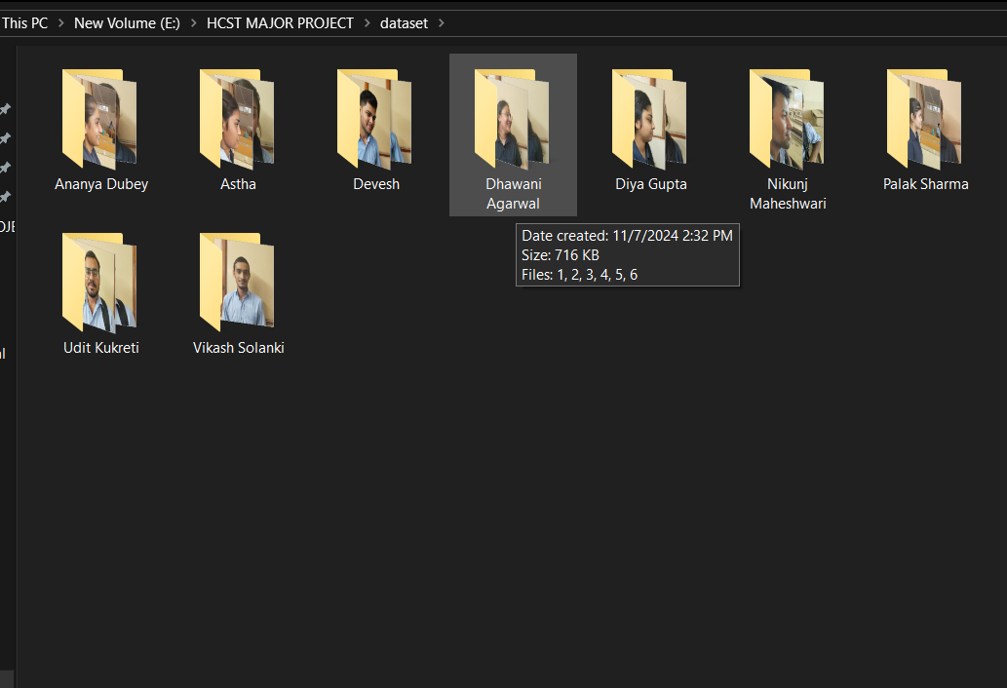
Size of Images
Second Folder (716 KB for 6 images)
Original image sizes:
154 KB
107 KB
115 KB
141 KB
97 KB
107 KB
Estimated Grayscale File Sizes:
Applying the 10-30% reduction rule for grayscale conversion:
154 KB → 90% of 154 KB = ~138 KB
107 KB → 90% of 107 KB = ~96 KB
115 KB → 90% of 115 KB = ~103 KB
141 KB → 90% of 141 KB = ~127 KB
97 KB → 90% of 97 KB = ~87 KB
107 KB → 90% of 107 KB = ~96 KB
Total estimated size after grayscale conversion: 138 KB + 96 KB + 103 KB + 127 KB + 87 KB + 96 KB = 647 KB Therefore, 9% reduction in size from 716 KB to 647 KB.

Slide 42
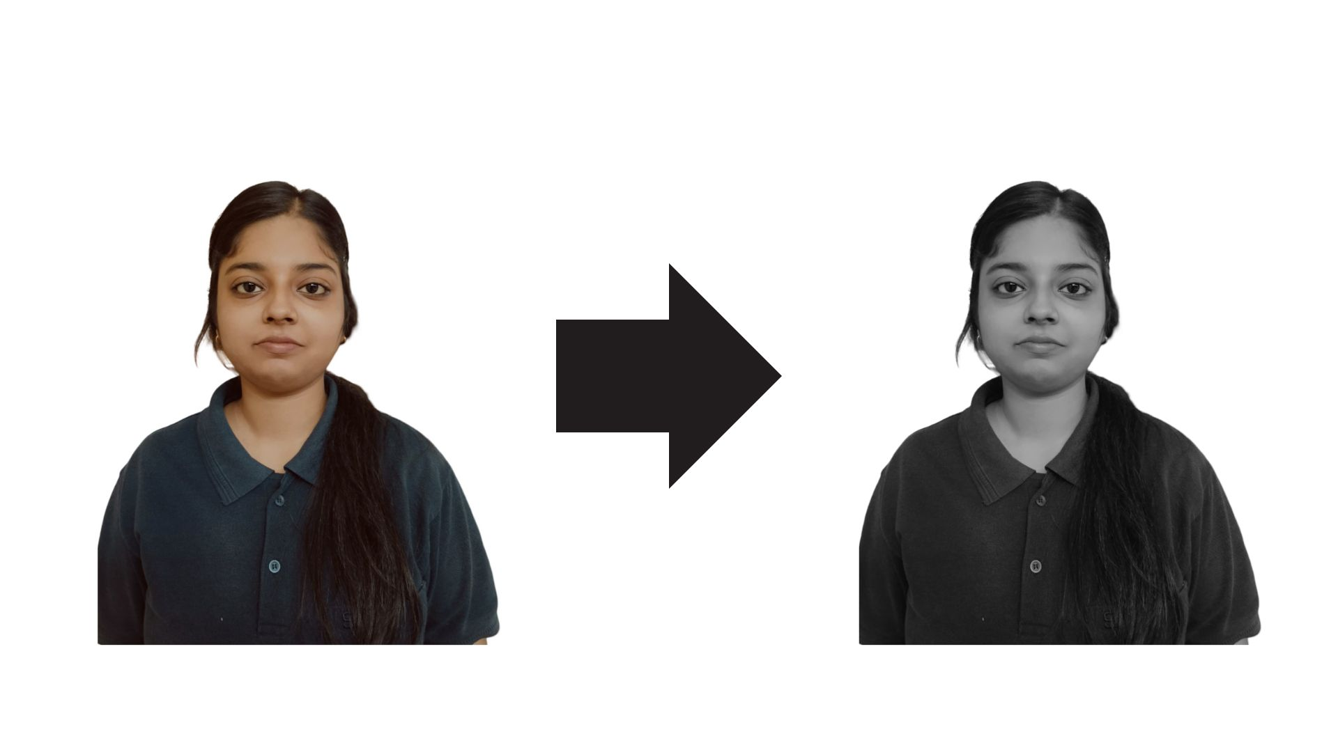
Converting Color Image to Grayscale

Slide 43
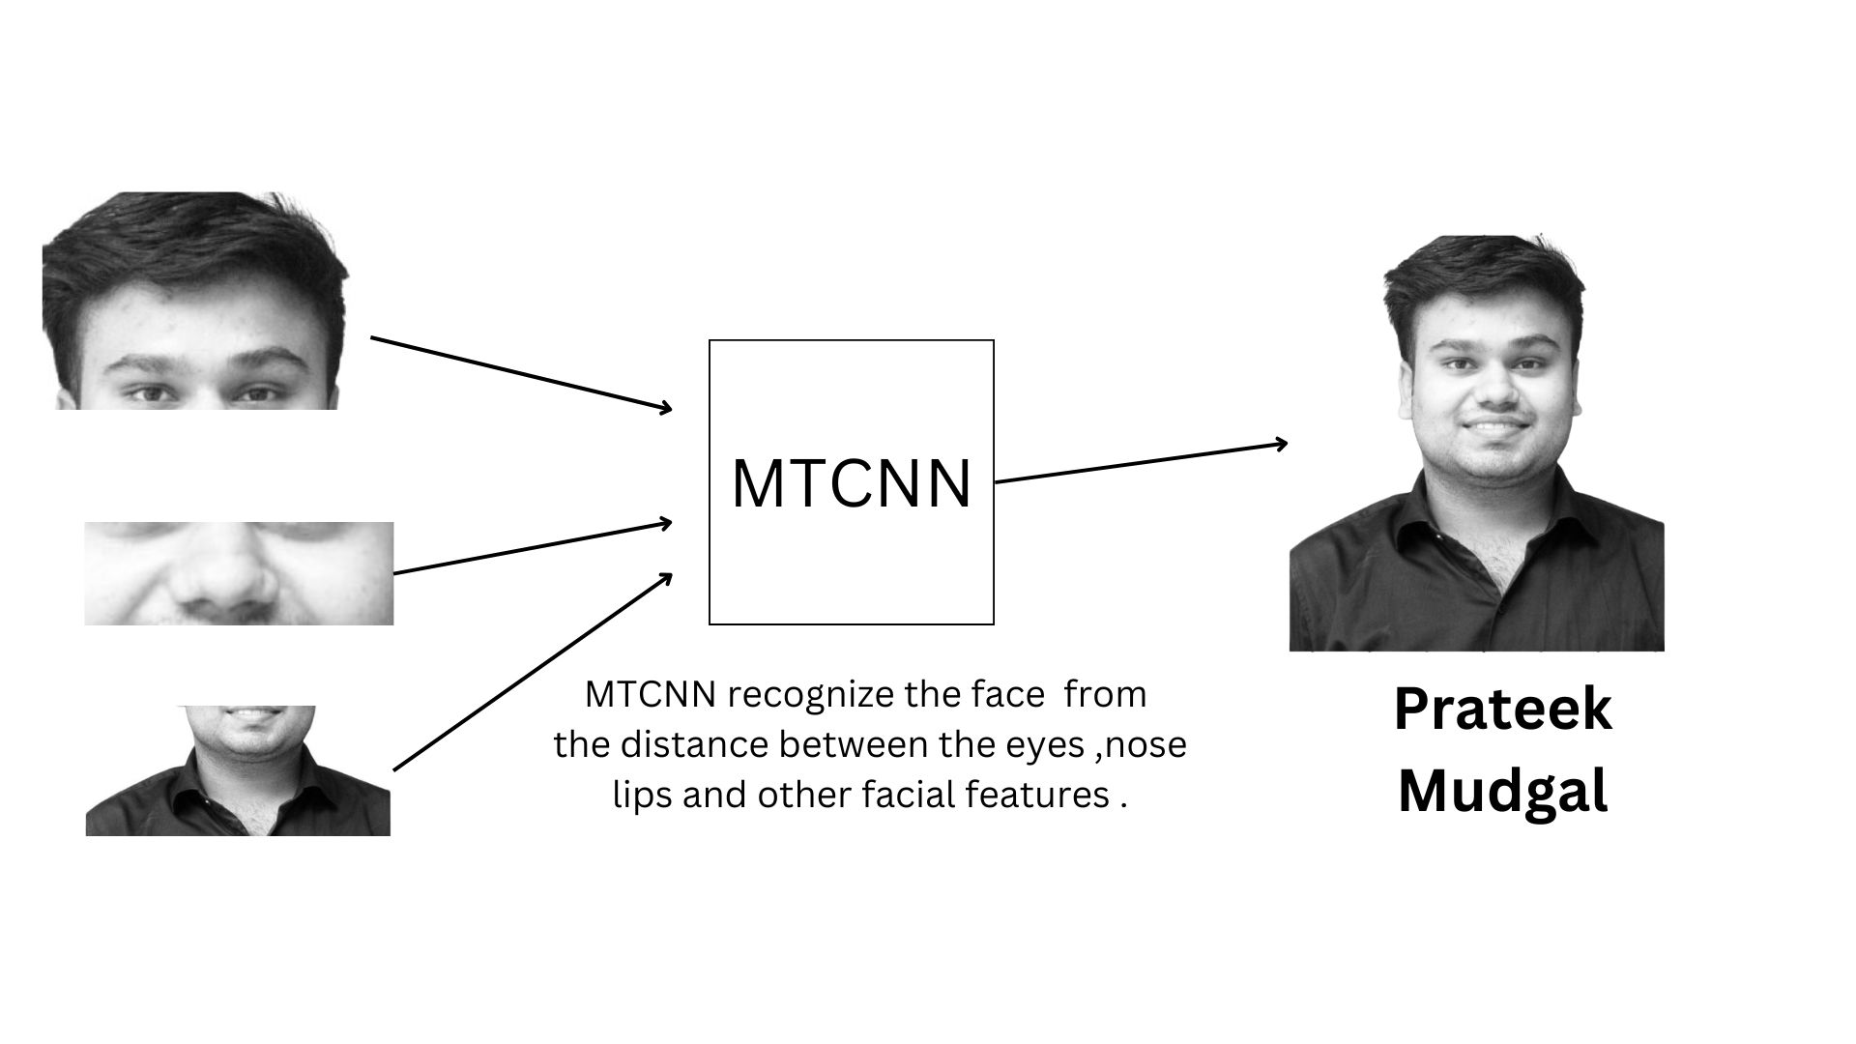
MTCNN Working

Slide 44
Algorithms Used
The aim of our proposed system is to mark attendance at real time of continuously scanning the faces (e.g. 30 minutes) .
The concept that we are using here is Neural Networks, which are majorly of two types:-
1. Artificial Neural Networks (ANN). 2. Convolution Neural Network (CNN).
i. Multi-Task Cascaded Convolutional Neural Network (MTCNN).

Slide 45
Deep Learning vs Machine Learning
Deep Learning
It’s a subset of machine learning that uses neural networks with many layers (deep layers).
The program learns features by itself from raw data, without much human intervention.
Machine Learning
It involves teaching a computer to make predictions or decisions based on structured data.
The program needs human help to choose which features (inputs) to look at for making decisions.
Notes:
Deep Learning- Example: Now imagine a student preparing for an exam without any specific guidance. Instead, they read the entire book and learn everything, identifying what’s important on their own. . They are so good that they can answer even unexpected, tricky questions because they’ve deeply understood the subject. NOTE- It figures out what’s important by itself.
Machine Learning- Example: Imagine you’re a teacher helping students prepare for an exam. You tell them exactly what to study:
You say, “Focus on chapters 1, 2, and 3 because the questions will come from these.”
The students then use these specific chapters to prepare for the test.
NOTE- You guide it by telling it what’s important.

Slide 46
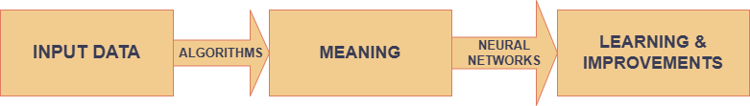
Neural Networks
A neural network is a method in artificial intelligence that teaches computers to process data in a way that is inspired by the human brain.
Notes:
EXAMPLE- On the first day at a new office, we meet several people. As we interact, we start to recognize them based on distinct features like whether someone has a beard, appears younger or older, or has a unique hairstyle. Our brain naturally picks up on these features to remember each person. When we return to the office the next day, we might notice some of these people look slightly different maybe someone trimmed their hair or shaved their beard. Despite these changes, our brain still recognizes them by matching the core features we learned before.
A machine, however, lacks this inherent ability. It would struggle to recognize individuals based on minor adjustments unless it is trained to do so. This is where machine learning and neural networks come in. By training a machine in a way that mimics the human brain’s system for recognizing faces and features, we enable it to "learn" and identify people, even if certain aspects of their appearance change.

Slide 47
Neural Network vs Deep Learning
Neural Network (NN):
It is a subset of machine learning.
It consists of one or a few layers of neurons (nodes).
Suitable for simple problems.
Deep Learning (DL):
It is a subset of neural networks with multiple (deep) layers.
It can learn complex patterns and features automatically.
Suitable for complex problems like image recognition, self-driving cars, etc.
Notes:
Neural Network (NN): Example: Think of it like a basic calculator. If you want to classify whether a fruit is an apple or banana, a neural network might use simple features like color and shape to decide.
Analogy: Imagine a student learning simple multiplication (e.g., 2 × 2). They can solve problems but only basic ones. Deep Learning (DL): Example: If we need to identify a specific type of apple among many different types of fruits in a photo, deep learning can handle this by automatically learning advanced features like texture, shading, and context.
Analogy: It’s like a student who has gone through multiple years of advanced mathematics classes. They can now solve complex calculus problems, not just simple multiplication.

Slide 48
Why MTCNN over ANN for Face Recognition
ANNs are not ideal for image data because they lack a way to consider spatial information (like edges or textures) in images.
Specialized design for face detection and alignment.
MTCNN is an advanced CNN that provides fast, accurate face detection with landmark alignment, crucial for a real-time facial recognition system.

Slide 49

Artificial Neural Network(ANN)
ANNs are the simplest form of neural networks, consisting of layers of interconnected nodes or "neurons."
They work well for structured data (such as numeric and categorical data in spreadsheets) and on smaller datasets.

Slide 50
Convolutional Neural Network (CNN)
CNNs are specifically designed for image processing and computer vision tasks.
They are structured to capture spatial and hierarchical patterns in images by using convolutional layers that scan images in small patches.
The unique feature of CNNs is that they can automatically detect key features (such as edges, corners, and textures) that help in recognizing objects and faces.
Convolutional Neural Network(CNN)
Multi-Task Cascaded Convolutional Neural Network(MTCNN)

Slide 51
ANN vs CNN vs MTCNN
Feature | ANN | CNN | MTCNN
Data type | Structured (numerical/tabular) | Image or spatial data | Real-time image data (face detection)
Primary use case | Classification, regression | Image classification, object detection | Face detection, facial landmark recognition
Real-life examples | Bank loan approval | Face recognition in smartphones | Surveillance camera face tracking
Key Strength | General-purpose | Feature extraction from images | Robust face detection and alignment
Specialization | No spatial feature handling | Detects spatial patterns | Detects faces and key facial features

Slide 52
MTCNN (Multi-Task Cascaded Convolutional Neural Network)
What is MTCNN?
MTCNN is a specialized CNN architecture tailored for real-time face detection and alignment.
It consists of three stages of CNNs that work in a cascade, refining the detection results through each stage, which makes it particularly accurate and robust.
Three-Stage Process:
Stage 1: Proposal Network (P-Net) - This network scans the image for candidate face regions and quickly rejects regions without faces.
Stage 2: Refine Network (R-Net) - The R-Net refines the candidates from the P-Net to improve the accuracy and reduce false positives.
Stage 3: Output Network (O-Net) - The O-Net further refines and identifies face landmarks (such as eyes, nose, mouth), helping align the face correctly.

Slide 53
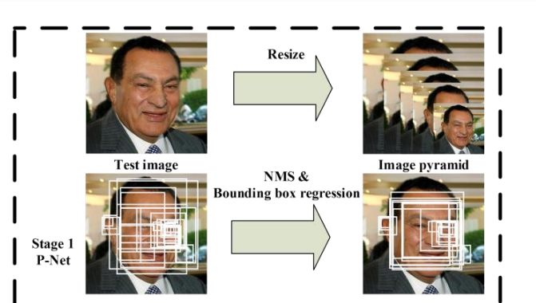
Stage 1: Proposal Network (P-Net)
In the first stage the MTCNN creates multiple frames which scans through the entire image starting from the top left corner and eventually progressing towards the bottom right corner. The information retrieval process is called P-Net(Proposal Net) , fully connected CNN.
Pipeline for MTCNN.

Slide 54
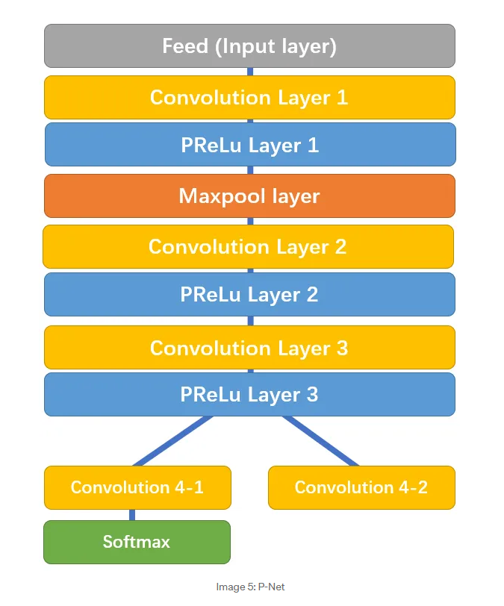
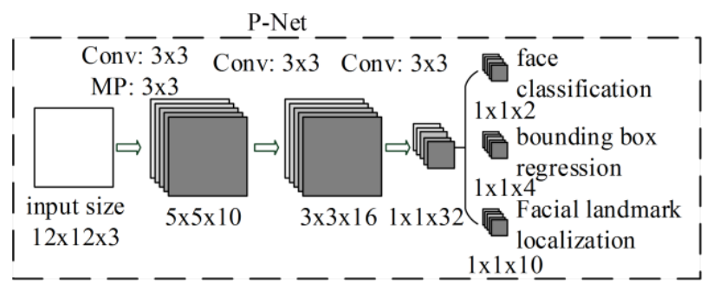
Working of P-Net
(Reference:
https://towardsdatascience.com/face-detection-neural-network-structure-257b8f6f85d1

Slide 55
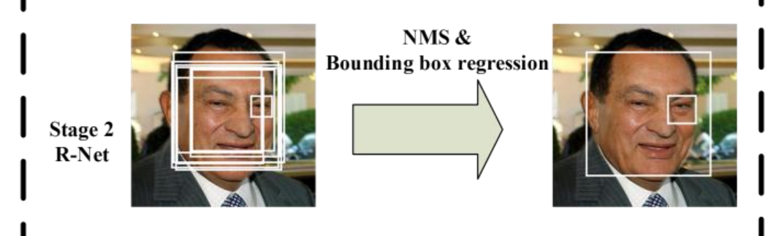
Stage 2: Refine Network (R-Net)
In the second stage all the information from P-Net is used as an input for the next layer of CNN called as R-Net(Refinement Network), a fully connected, complex CNN which rejects a majority of the frames which do not contain faces.
Pipeline for MTCNN.

Slide 56
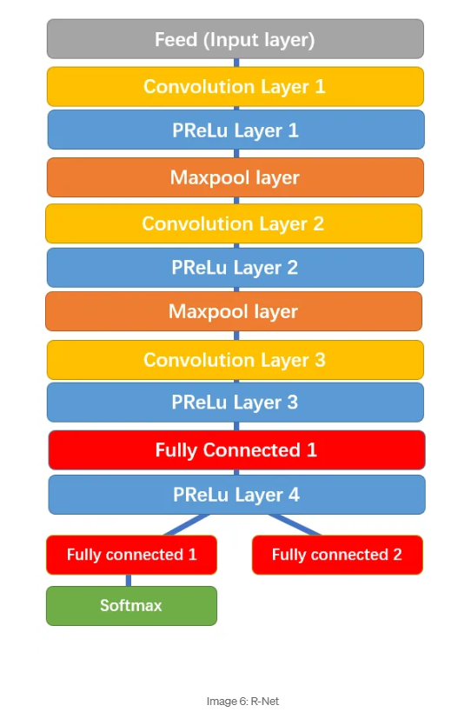
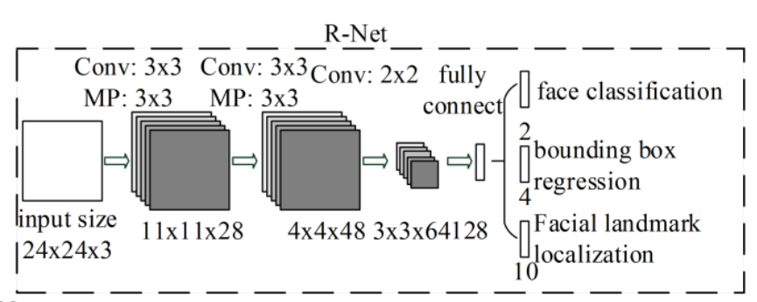
Working of R-Net
(Reference:
https://towardsdatascience.com/face-detection-neural-network-structure-257b8f6f85d1

Slide 57
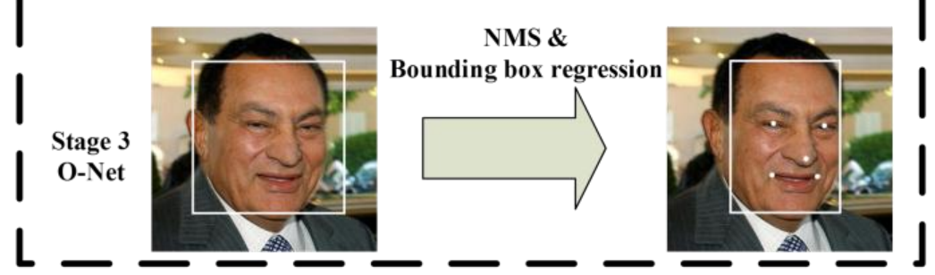
Stage 3: Output Network (O-Net)
In the third and final stage, a more powerful and complex CNN, known as O-Net(Output Network), which as the name suggests, outputs the facial landmark position detecting a face from the given image/video.
Pipeline for MTCNN.

Slide 58
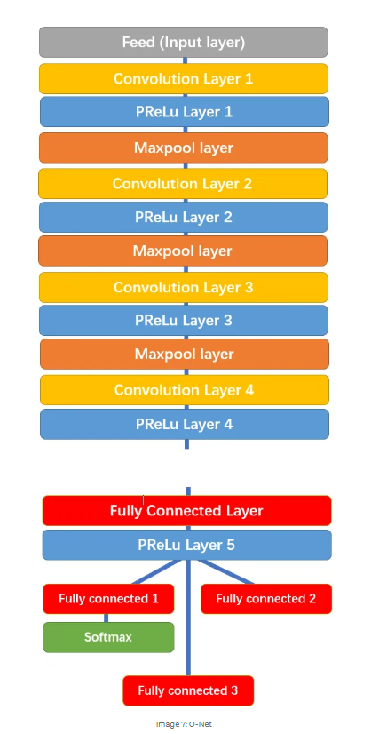
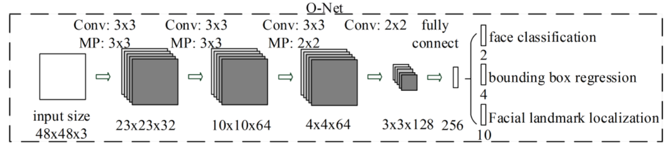
Working of O-Net
(Reference:
https://towardsdatascience.com/face-detection-neural-network-structure-257b8f6f85d1

Slide 59
Why Deepface is used?
Simplified Integration:- DeepFace abstracts away the complexities of deep learning and facial recognition. It offers a high-level API, making it easy to use with just a few lines of Python code.
Supports Face Detection, Verification, and Analysis:- In our application, we needed not only face recognition (identifying a person) but also verification (checking if two faces belong to the same person).
DeepFace provides built-in functions like verify(), analyze(), and find(), covering most facial recognition use cases.
Cross-Platform Compatibility:- DeepFace is compatible with popular Python libraries like TensorFlow, Keras, and PyTorch. It can be easily integrated into your existing Python applications, whether we are using Flask, Django, or a data analysis tool like Streamlit.
How DeepFace Differs from Other Technologies:
Feature | DeepFace | Other Technologies
Ease of Use | high-level API, quick setup | requires extensive coding/setup
Face Alignment | use MTCNN for accurate alignment | may not include built-in alignment
Open Source | open source and customize | some of them are paid

Slide 60
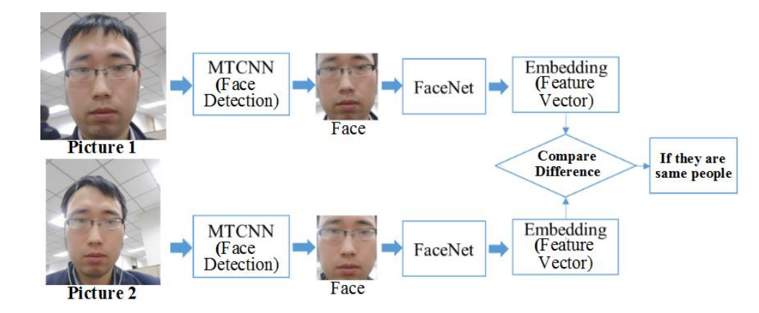
DeepFace for Embedding Extraction
DeepFace, a deep learning model, processes the aligned face images and generates an embedding vector for each face.
This embedding is a high-dimensional numerical representation (vector) that captures unique features of the face, such as shape, texture, and proportions.
How does this work?
The neural network in DeepFace extracts patterns from the face, ignoring irrelevant variations like lighting or background.
The embedding typically resides in a lower-dimensional space (e.g., a 128-dimensional vector) to simplify comparisons.
DEEPFACE
DEEPFACE
(Reference:
https://iopscience.iop.org/article/10.1088/1742-6596/1518/1/012066/pdf

Slide 61
Comparing Feature Vectors
What happens here?
The embedding vectors for Picture 1 and Picture 2 are compared using a mathematical distance metric, often the cosine similarity.
These metrics calculate how "close" or "similar" the two embeddings are in the feature space.
How does the comparison work?
If the distance between the embeddings is below a threshold (predefined by the system), the two faces are considered to belong to the same person.
If the distance exceeds the threshold, the faces are identified as different people.
DEEPFACE
(Reference:
https://iopscience.iop.org/article/10.1088/1742-6596/1518/1/012066/pdf
DEEPFACE

Slide 62
Identifying the Same Person
If the faces belong to the same person:
The embeddings are very similar (low distance or high similarity).
The system outputs a confirmation that the two images represent the same individual.
If the faces belong to different people:
The embeddings are distinct (high distance or low similarity).
The system outputs a result indicating that the images represent different individuals.
DEEPFACE
DEEPFACE
(Reference:
https://iopscience.iop.org/article/10.1088/1742-6596/1518/1/012066/pdf

Slide 63
Why MTCNN in Our System?
DEEPFACE
DEEPFACE
(Reference:
https://iopscience.iop.org/article/10.1088/1742-6596/1518/1/012066/pdf

Slide 64
Why MTCNN in Our System?
Accurate Face Detection:
For real-time facial recognition, accuracy is essential. MTCNN’s cascade architecture effectively reduces false positives and detects faces accurately.
Face Alignment:
Accurate alignment is vital for facial recognition since minor misalignments can reduce recognition accuracy. MTCNN’s landmark detection helps precisely align faces, making downstream recognition (e.g., using DeepFace) more accurate.
Real-Time Processing:
MTCNN’s multi-stage design allows it to quickly filter out irrelevant regions, focusing only on potential face regions, which makes it efficient for real-time applications. This is particularly useful in an automated attendance system, where faces need to be quickly detected in a live environment.
Compatibility with Recognition Models:
MTCNN outputs aligned face images that can easily be fed into other facial recognition models (like DeepFace or FaceNet) for recognition. This integration improves recognition speed and accuracy in a real-time system.

Slide 65
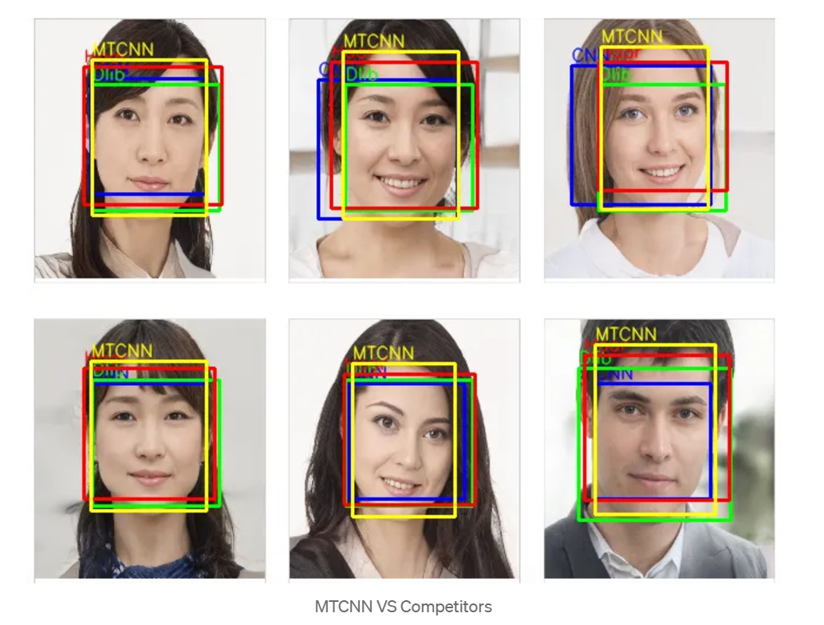
MTCNN Competitors
DLIP, or Deformable Part-based models for Object Detection with Particular application to Human Faces, is a popular object detection algorithm that has been used for face detection. While it has shown good performance in some studies, it can be slow and requires a large number of training images.
CNN, or Convolutional Neural Networks, is a widely-used algorithm in computer vision tasks, including face detection. While it can achieve high accuracy, it can be computationally expensive and time-consuming, making it less suitable for real-time applications.
Haar cascades is a classic face detection algorithm that uses Haar-like features to detect faces. It is fast, but its accuracy is not as high as that of MTCNN. MTCNN, on the other hand, has been found to be faster and more accurate than Haar cascades, making it a popular choice for face detection tasks.

Slide 66
Language Used
Language used – Python 3.12.6
Libraries:
OpenCV
Numpy, pandas
Deepface, TensorFlow
Visual Studio code – 1.95.3

Slide 67
Why Python
Interpreted Programming Language
Supports Operator overloading
Provide both single and multiple inheritance
Platform Independent
Use of ; is not compulsory.
Has a huge set of libraries that make it fit for AI, datascience
Smaller code length
Functions and variables can be declared and used outside the class also.

Slide 68
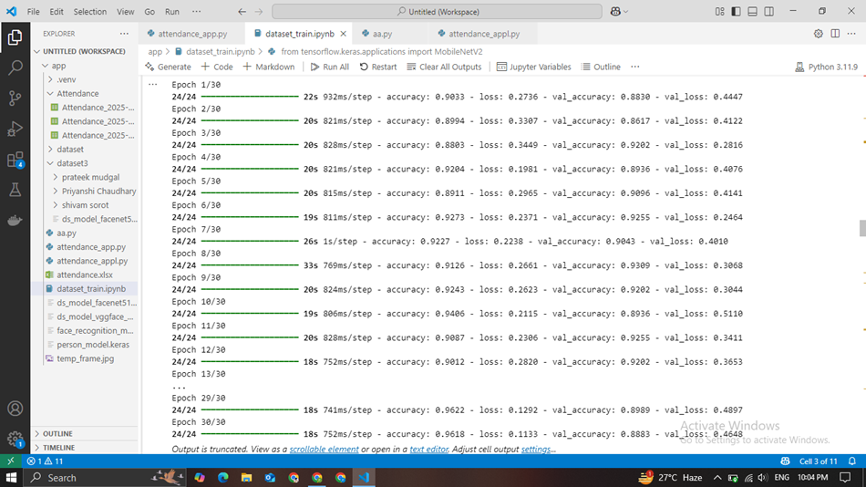
Model Training
Train at locally:

Slide 69
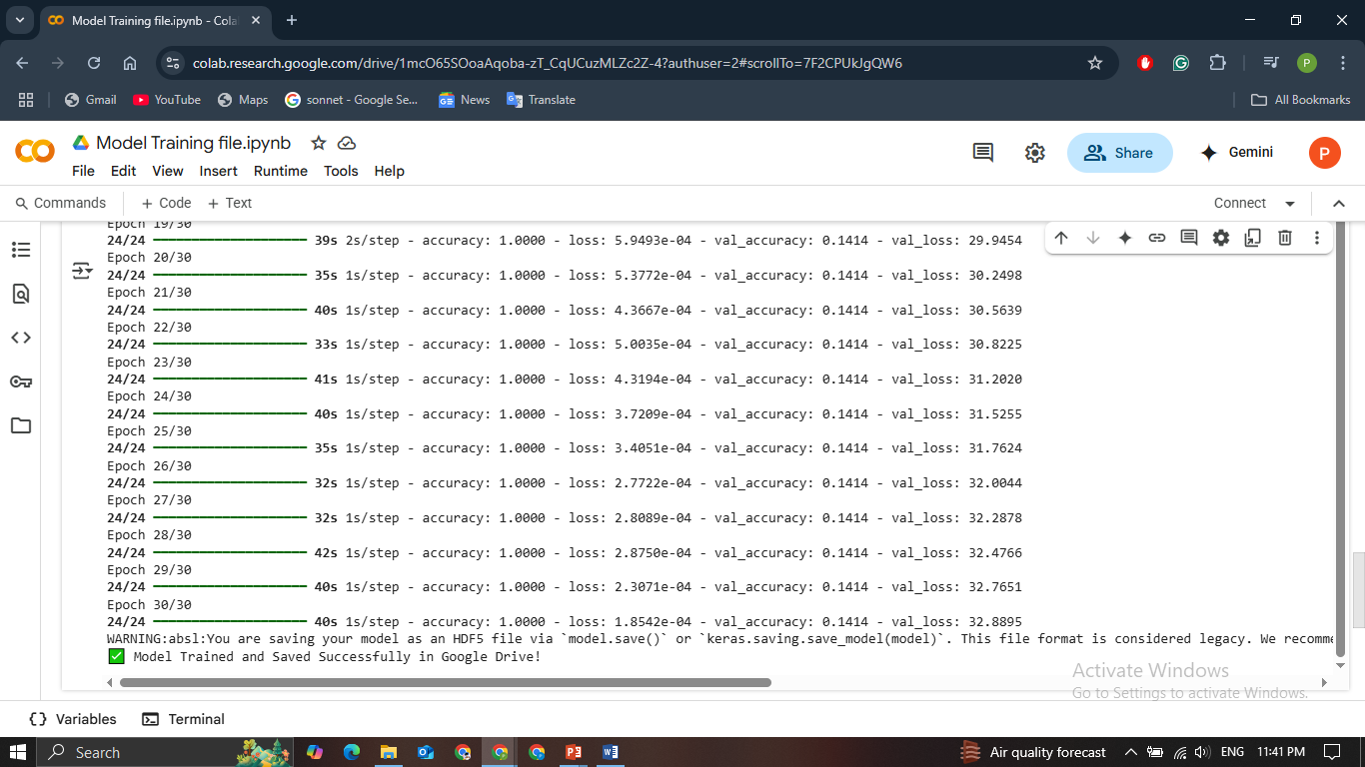
Train at Goggle Collab:

Slide 70
Outcome
Model | Accuracy | Real-Time Speed | Robustness | Scalability
Custom CNN | 70% | Moderate | Low | Poor
MTCNN | 80% | Slow | Moderate | Limited
FaceNet 512 | 95% | Fast | High | Excellent

Slide 71
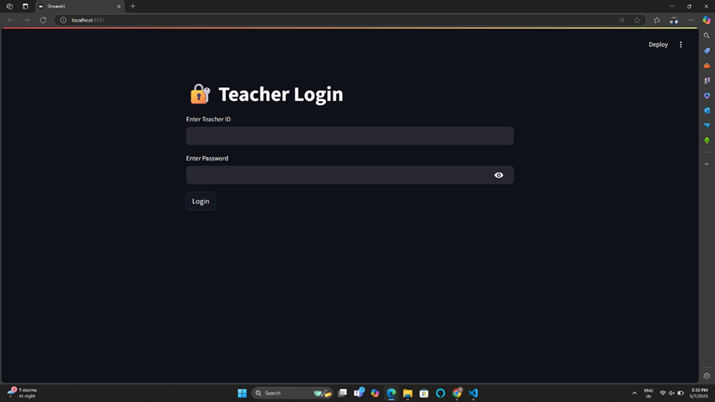
User Interface (UI) Development
Screen 1: Login to the system

Slide 72

Screen 2: Entry Screen for Class Session

Slide 73
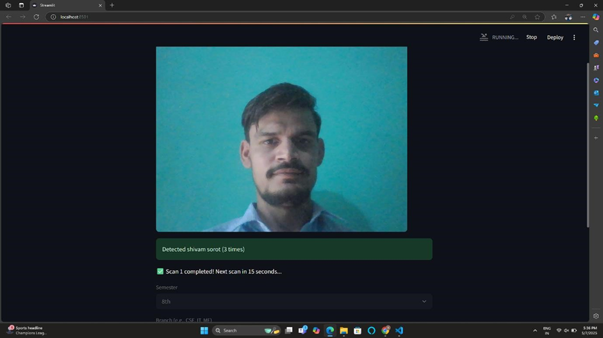
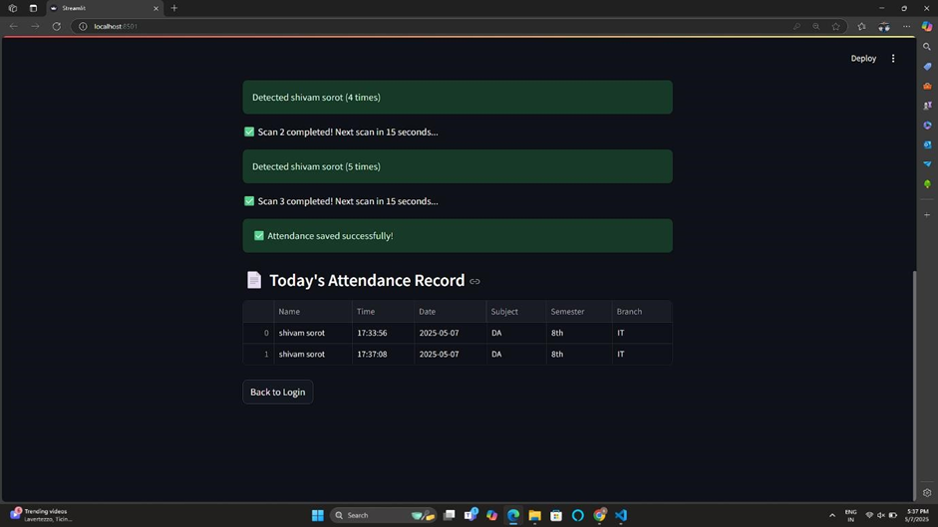
Screen 3: Face Scanning & Attendance

Slide 74

Screen 4 (Attendance Summary Screen)

Slide 75
Future Scope
Integration with Cloud Technology
Adaptability for Bigger Populations
Multi-Factor Authentication
Real-Time Alarms and Analytics
Security and Compliance

Slide 76
THANK YOU

